Slide 1



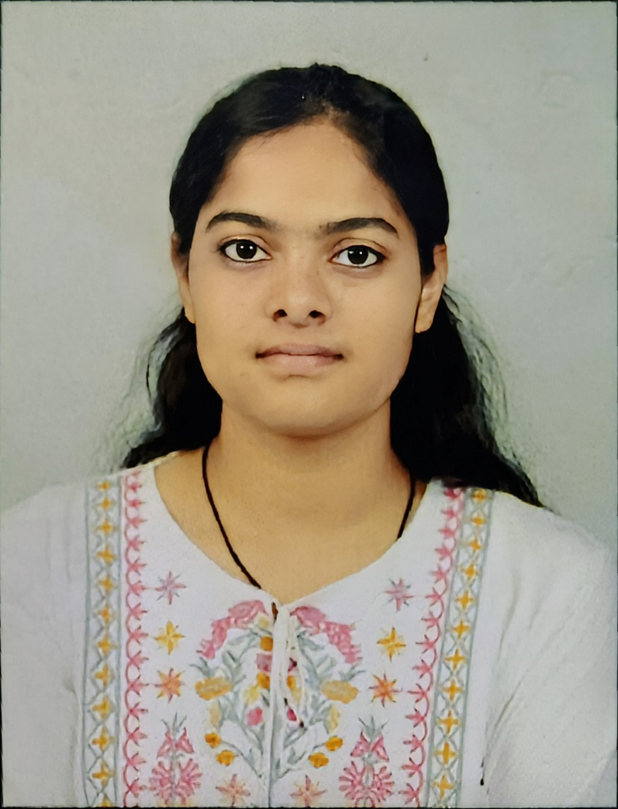

Hack the Future: A Gen AI Sprint Powered by Data
Data and AI Week
Team details
Geekers :
•
•
Harsh Jeswani
Muskan Kushwaha (Team Leader)

Slide 2
Entry Submission Summary
Idea Title (Provide a concise and impactful title for your idea) | Learning And Training through AR/VR glasses
Team Name | Geekers
Problem Statement | • Visualization Difficulties • Example – Data Structures and Algorithms (DSA) • Limited Accessibility
Proposed Solution | ▪ AR/VR Labs Setup ▪ Applications For AR/VR Learning Labs ▪ Connecting Multiple VR Headsets to a Single Screen ▪ Providing Full Time Courses in 3D.

Slide 3

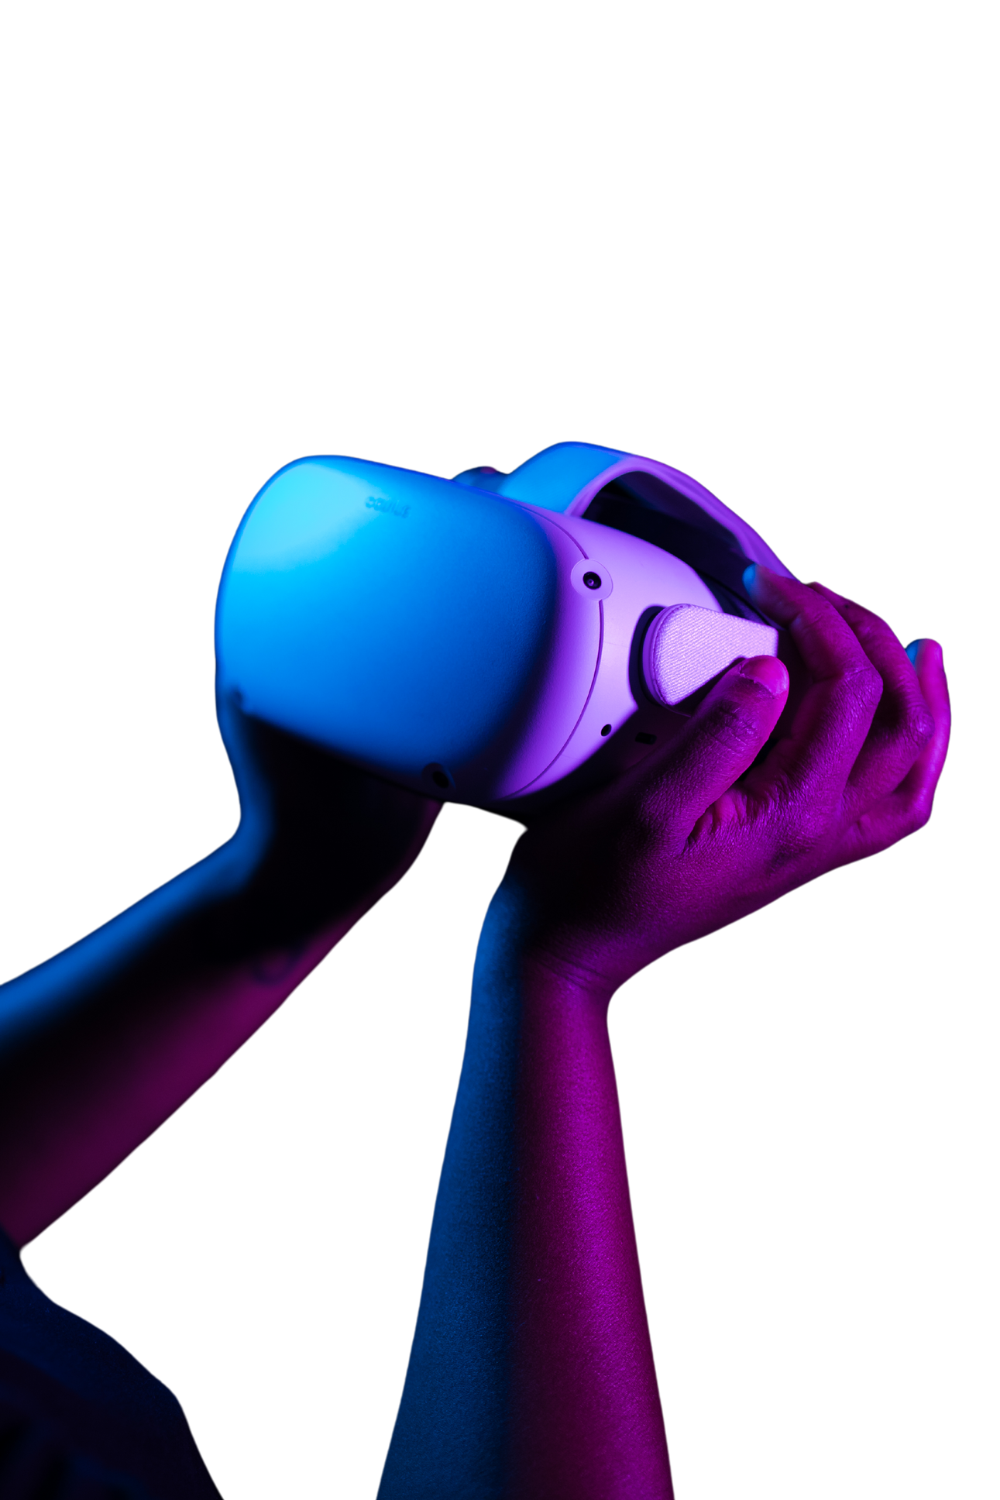

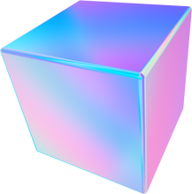
Problem Statement
▪ Difficulty in visualizing complex concepts. ▪ As a student of CSE we can take an example of DSA. It Feels too complicated to understand it on board, or imagining it while sitting in classrooms .
▪ They aren't always accessible to everyone, especially students with disabilities like hearing.
▪ Unable to connect multiple VR glasses to a single server, as it helps in teaching or training multiple students at a time with same content.

Slide 4
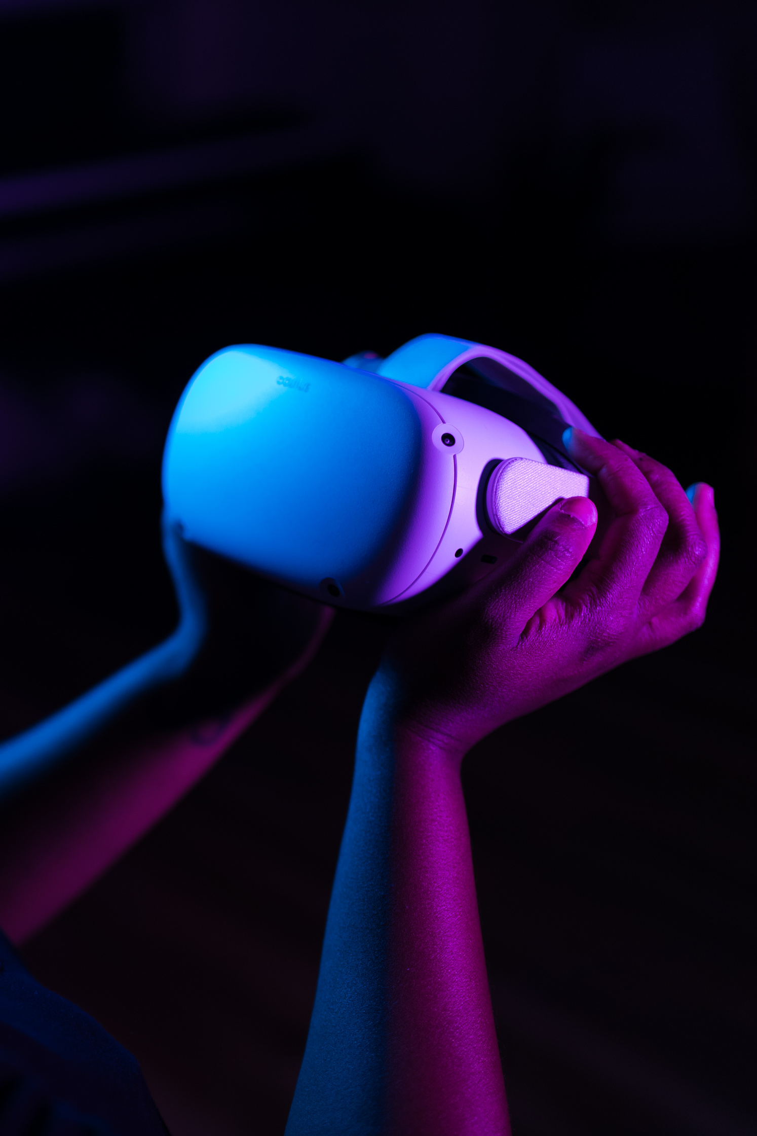
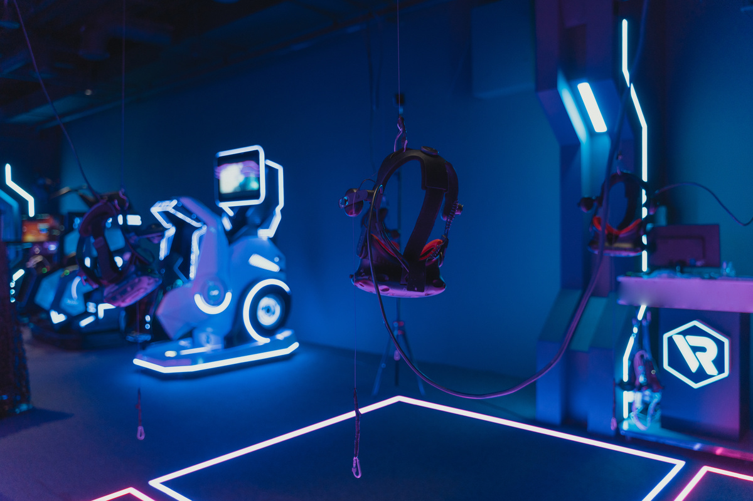

Proposed Solution Overview
Geekers
START
INTEGRATE INTERACTIVE FEATURES ADD ASSESSMENT/QUIZZES
DEPLOY ON PLATFORMS
INPUT DATA: UPLOAD SYLLABUS
EXTRACT KEY CONCEPTS
TESTING &
FEEDBACK
USER INTERACTION AUDIO/VIDEO INTEGRATION
CONVERT THEORY INTO 3D MODELS/SCENES
LAUNCH &
UPDATE
USER INTERFACE DESIGN
3D MODELING ANIMATIONS/SIMULATIONS
GAMIFICATION (OPTIONAL)
END

Slide 5
Problem : Physical training in fields like construction, manufacturing, or healthcare can be risky and expensive.
Solution :
No real-world hazards
Learn from mistakes without consequences
VR can simulate dangerous scenarios (like a fire or machine failure) to train people on how to respond safely.
Problem : Some subjects are hard to grasp from books or 2D diagrams.
Solution :
Immersive visualization
3D modeling
Interactive learning
Improved retention
NASA’s AR/VR for Astronaut Training
Medical Schools Using VR
GEEKERS

Slide 6
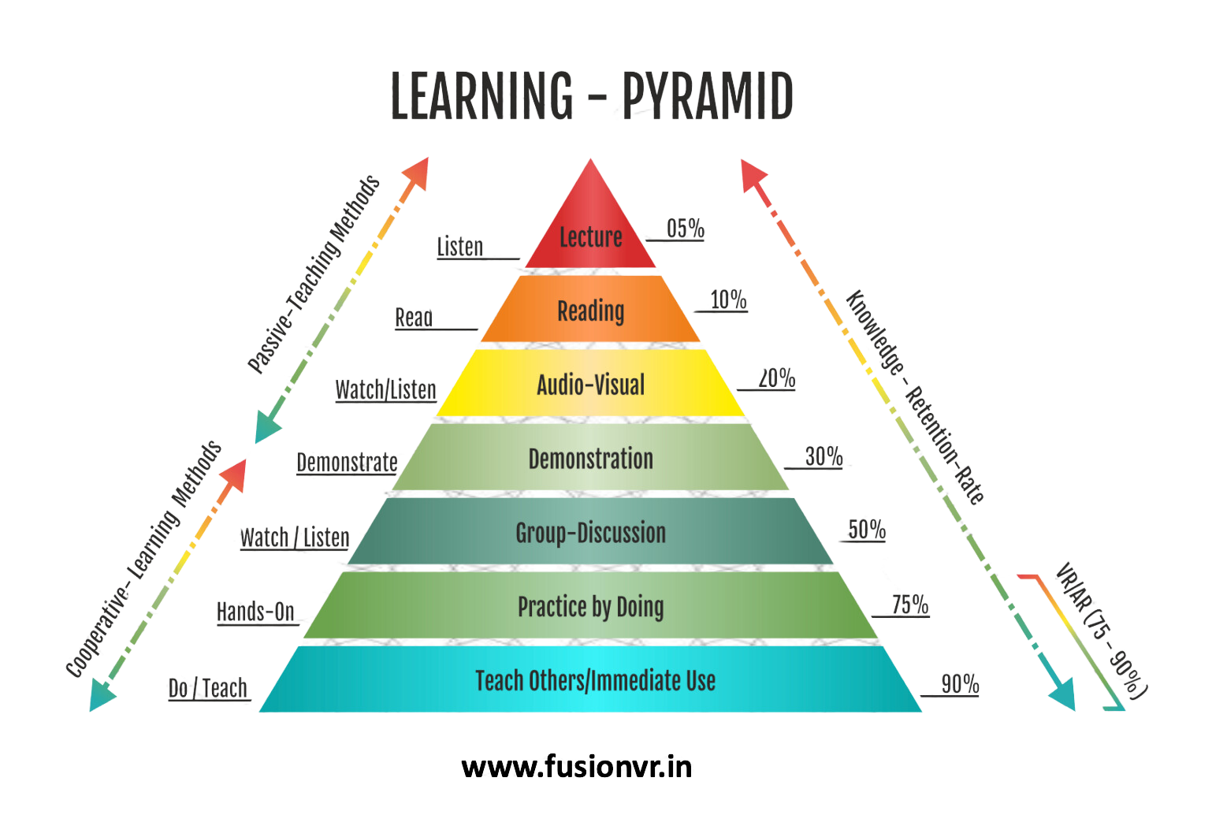
References/Other details
Using our application, Multiple VR Glasses can connect to a single server.
In this way it will be helpful training and teaching students in bulk.
Competition
Acc. to our research, on one in the market do so.

Slide 7
Thank You

